Slide 1
BLOCKCHAIN
19AIE431 Applied Cryptography
Adhithan P CB.EN.U4AIE19003
Dinesh S CB.EN.U4AIE19025
Kabilan N CB.EN.U4AIE19033
Shankar P CB.EN.U4AIE19049

Slide 2
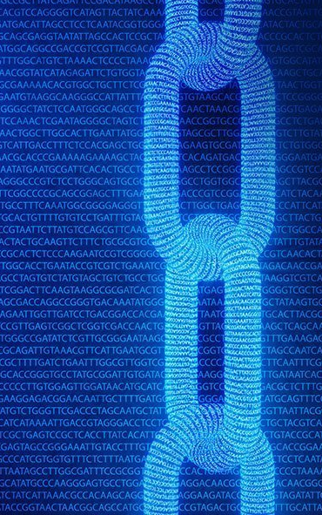
OVERVIEW
In this project we’ll be discussing Blockchain and various keywords in blockchain like hashing, Cryptographic Algorithms, Transactions, blocks, smart contracts, IPFS, Consensus algorithms, Dapps and NFTs.
Along with simple blockchain implementation in python followed by a complete decentralized voting application on top of Ethereum Blockchain.

Slide 3
A blockchain is essentially a digital ledger of transactions that is duplicated and distributed across the entire network.
Many think that blockchain is only for cryptocurrency. Blockchain is a technology. Cryptocurrencies are merely the first mainstream manifestation of its potential.
Each block in the blockchain contains a number of transactions, when a new transaction occurs on the blockchain, a record of that transaction is added to every participant’s ledger.
Blockchain is a type of DLT in which transactions are recorded with an immutable cryptographic signature called a hash.

Slide 4
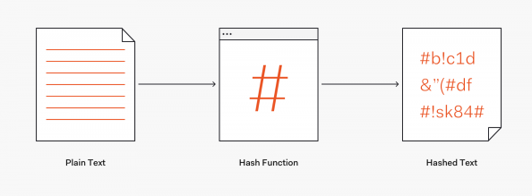
HASHING
#
Hash is an algorithm which converts a variable data to an alpha-numeric string of fixed length. Even if there is a minor change in the data the hash will completely change. All the blocks are connected to it’s previous block by having the hash of the previous block.

Slide 5

THE FUNDAMENTALS OF CRYPTOCURRENCIES
Every person has a unique key associated with them , Using that key they make the transactions or receive funds.
Public blockchains like Bitcoin, Ethereum are open for all, anybody can see the contents and verify.
Now also we can see the Blocks created by Satoshi Nakamoto, who created bitcoin.

Slide 6
CHARACTERISTICS OF BLOCKCHAIN
Every block in a blockchain is built up on the previous block and has the value of previous hash to form chains..
Blocks over the chain are validated and confirmed by the miners..
01
02
Consensus algorithms make sure all the transactions are validated and only added once in the blockchain. These algorithms are run by miners and the miners get rewarded for running it.
03
Blocks in a blockchain are cryptographically sealed, which means that it is nearly impossible to delete or modify data over the blockchain.
04
06
All the blocks in a blockchain are chronologically ordered and time-stamped.
05

Slide 7
SOME KEY TERMS IN BLOCKCHAIN
Public Keys
Public keys are generated from private Keys. They are open to the public as they help the participants to verify the data.
Digital Signatures
Digital Signatures are the identity proofs for the people who are transacting over blockchain.
Addresses
Addresses are derived from public keys. Address represents a possible destination for a cryptocurrencies payment or a data upload.
Private Keys
Private Keys are used to generate signatures for each transaction over the blockchain.
Transactions
Transactions are records of data in chronological order. They are stored in a Merkle tree inside the block.

Slide 8
KEY GENERATION ALGORITHMS
Keys in cryptography is a string of alpha-numeric characters which secures the data by encoding it.
Symmetric Cryptography Algorithm | Asymmetric Cryptography Algorithm
Symmetric Cryptography Algorithm uses only one key for both encryption and decryption | Asymmetric Cryptography Algorithm contains two cryptographic keys for encryption and decryption known as public and private keys
Symmetric Cryptography is much faster compared to Asymmetric Cryptography | As Asymmetric Cryptography incorporates two separate keys, the process is slowed down considerably
RC4 AES DES 3DES QUAD | RSA Diffle-Hellman ECC El Gamal DSA

Slide 9
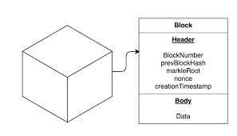
BLOCKS
A Block is a container data structure which contains a set of confirmed transactions.
Each block contains a cryptographic hash of the previous block, a timestamp, and transaction data.
A block could contain different information and a chain of these blocks using the previous hash value forms the complete Blockchain.
Structure of a block
Block Headers
Block identifiers
Merkle Trees

Slide 10
BENEFITS OF BLOCKCHAIN
Better Transparency
A
Enhanced Security
it’s relatively easier to reach full transparency with blockchain. In Blockchain everything is open for all users to see.
All the data that is written to the blockchain has to obey the rules of consensus. The data is added to the blockchain only after full verification by the peers.
B
C
Decentralization
True Traceability
Decentralized networks strive to reduce the level of trust that participants must place in one another, and deter their ability to exert authority or control over one another.
With the help of blockchain technology, enterprises can reach true traceability in their supply chain management system that will benefit both the suppliers and the manufacturers.
D

Slide 11
SMART CONTRACTS
Ethereum has the functionality of smart contracts that can automatically perform logical operations based on a set of criteria established in a blockchain.
Smart Contracts are the digital contracts or immutable agreements used to create a mirror of a legal agreement between two parties and stored over the immutable ledger.
They typically are used to automate the execution of an agreement so that all participants can be immediately certain of the outcome, without any intermediary’s involvement or time loss.
Smart contracts help you exchange money, property, shares, or anything of value in a transparent, conflict-free way while avoiding the services of a middleman.

Slide 12
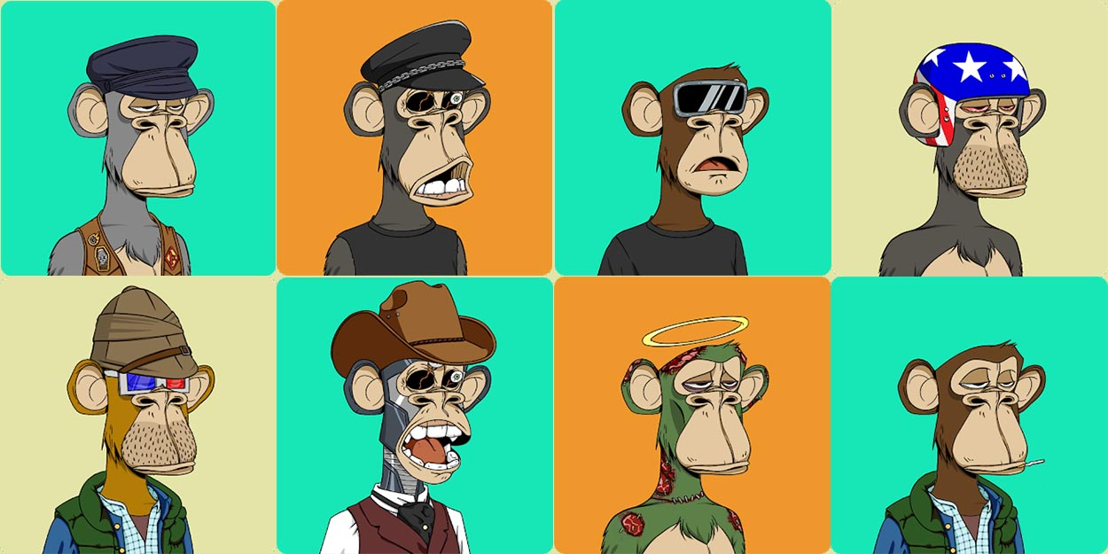
NON- FUNGIBLE TOKENS (NFTs)
NFTs are tokens that we can use to represent ownership of unique items.
No one can modify the record of ownership or copy/paste a new NFT into existence
Some crypto punk NFT’s
Fungible Tokens | Non – Fungible Tokens
Fungible Tokens can be exchanged with other tokens of the same type | Non- Fungible Tokens cannot be exchanged with similar type NFT’s
All Fungible Tokens are identical to each other | NFT’s are unique and not similar to each other
Fungible Tokens can be divided into smaller units | NFT’s cannot be divided but are one entire unit

Slide 13
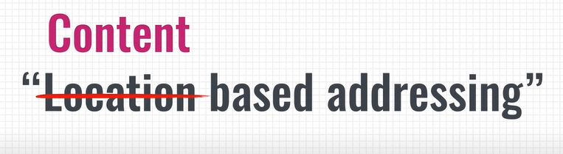
THE INTERPLANETARY FILE SYSTEM (IPFS)
It is a protocol and peer-to-peer network for storing and sharing data in a distributed file system.
IPFS is built around a decentralized system of user-operators who hold a portion of the overall data, creating a resilient system of file storage and sharing.
If we want to download a photo from the internet. In this case the location of the photo is the IP address or the domain name. This is called “location based” addressing. But if that location isn’t accessible /the server is down. So we won’t get the photo. To fix this, IPFS moves from “location based” addressing to content based” addressing.

Slide 14
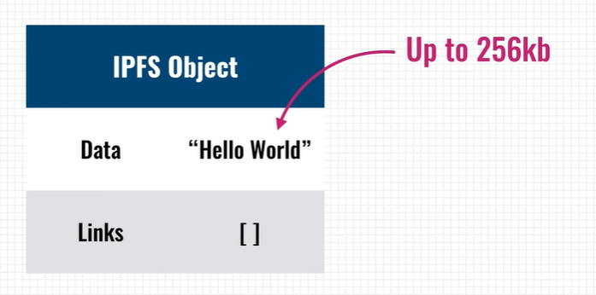
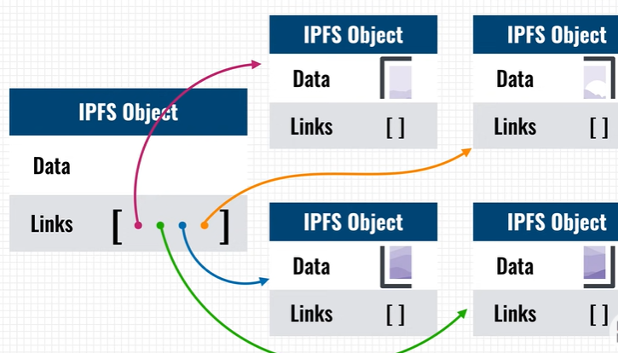
HOW IPFS STORES FILES AND MAKES THEM ACCESSIBLE TO OTHERS.?
Files are stored inside IPFS objects and these objects can store up to 256kb worth of data and can contain links to other IPFS objects. A simple “Hello World” text file, which is very small, can be stored in a single IPFS object.
Like an image or video for instance. Those are split up into multiple IPFS objects that are all 256kb in size and afterwards the system will create an empty IPFS object that links to all the other pieces of the file. The data architecture of IPFS is very simple and yet it can be very powerful. anymore. It’s an immutable datastore much like a blockchain.

Slide 15
CONSENSUS ALGORITHMS
A consensus algorithm is a process used to achieve agreement on a single data value among distributed processes or systems.
Some of the most used consensus Algorithms are
Proof of Work
Proof of Stake
Proof of Authority
These algorithms are designed as fault tolerance because there is a possibility that some processes and systems become unavailable and that some communications will be lost.

Slide 16
PYTHON IMPLEMENTATION OF BLOCKCHAIN

Slide 17
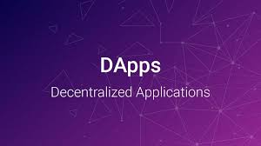
DApps are digital applications or programs that exist and run on a blockchain or peer-to-peer (P2P) network of computers instead of a single computer
As DApps are decentralized, they are free from the control and interference of a single authority.

Slide 18
BLOCKCHAIN BASED VOTING SYSTEM

Slide 19
VOTING DAPP
Voting with blockchain carries the potential to eliminate election fraud and boost voter turnout.
Using blockchain in this way would make votes nearly impossible to tamper with.
The blockchain protocol would also maintain transparency in the electoral process, reducing the personnel needed to conduct an election and providing officials with nearly instant results.

Slide 20
VOTING FLOW
01
02
03
04
This dapp holds an election between two candidates.
voters need an account with a wallet address with some Ethers.
Once Voters connect to the network, they can cast their vote
Voters pay a small transaction fee to write their votes to the blockchain.
06
07
06
05
05
Smart contracts represents agreements for taking the valid votes.
Miner who completes this transaction is awarded the Ether that voters paid to vote.
Candidate with most votes wins.

Slide 21
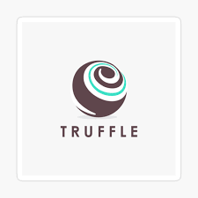
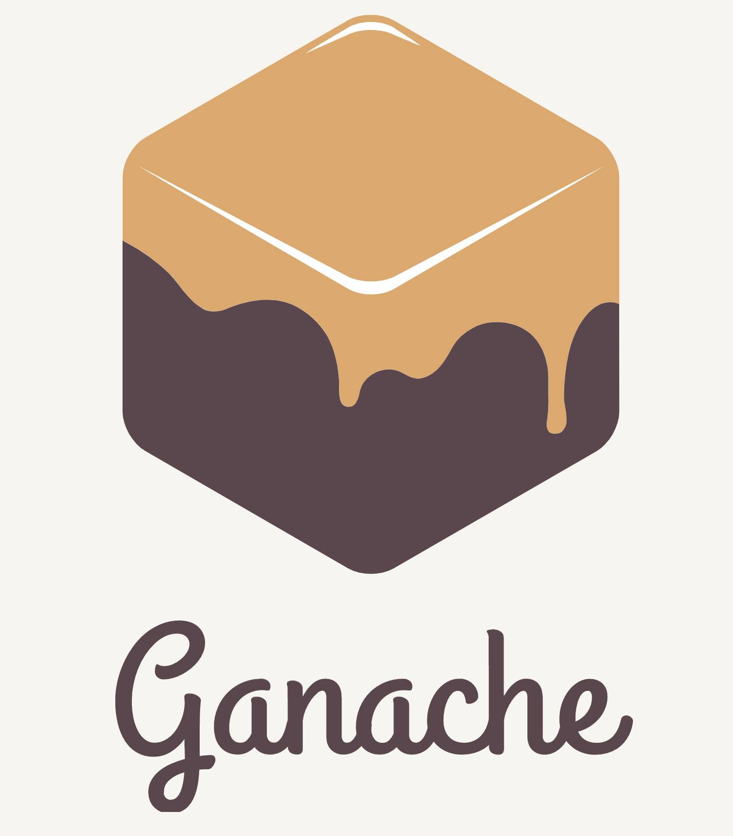
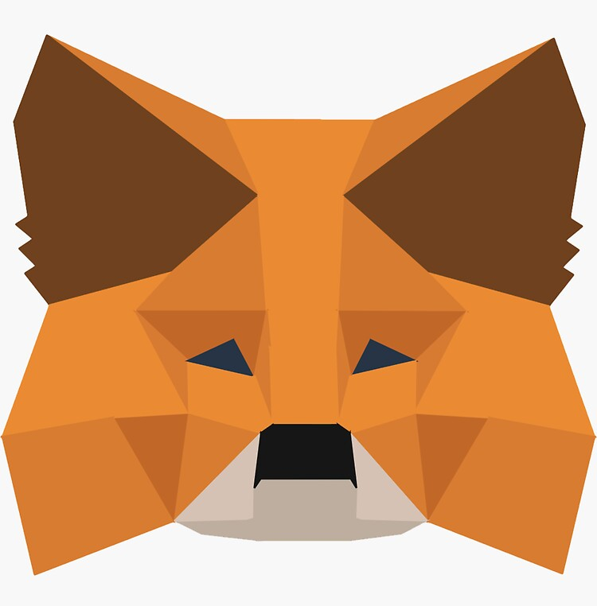
SETTING UP THE ENVIRONMENT
Truffle Framework
Truffle Framework, which allows us to build decentralized applications on the Ethereum blockchain. It provides a suite of tools that allow us to write smart contacts with the Solidity programming language. It also enables us to test our smart contracts and deploy them to the blockchain.
Ganache
Ganache is a local in-memory blockchain. It will give us 10 external accounts with addresses on our local Ethereum blockchain. Each account is preloaded with 100 fake ether. We can use these fake ethers for our transactions
Metamask
Metamask is a chrome extension that helps us to connect to our local Ethereum blockchain with our personal account, and interact with our smart contract.

Slide 22
FRAMEWORK
build/contracts | Election.json | Migration.json contracts | Election.sol | Migration.sol migrations | 1_initial_migration.js | 2_deploy_contracts.js node_modules src | css | fonts | images | js | app.js | truffle-contract.js | index.html test | election.js truffle.js
contracts : This directory contains all the smart contracts.
Migrations : This directory contains all of the migration files. When a smart contract is deployed to the blockchain, the blockchain's state is updated, and therefore needs a migration.
node_modules : This directory contains all the dependencies.
src : In this directory the client-side application or the front-end is defined.
test : This directory contains all the test files for our smart contracts.
truffle.js: This is the main configuration file for the Truffle project.

Slide 23
THANK YOU

